Slide 1
Requirements Engineering

Slide 2
Requirement Modeling & Analysis
Requirement Analysis - Understand the problem before you begin to create requirements specification
Don’t solve the wrong problem
The process of reasoning about the requirements that have been elicited
Examining requirements for Conflicts, Inconsistencies, Omissions, Ambiguity
Combining related requirements
Categorizing requirements
Organizing requirements into related subsets
Analyzing requirement feasibility
Exploring relationship between requirements
Prioritizing requirements according to the needs of users

Slide 3
Requirement Analysis
Requirements
Checking
Requirement
Specification
Domain
Understanding
Prioritization
Requirements
Collection
Conflict
Resolution
Classification
Requirements
Document

Slide 4
Requirements analysis and negotiation

Slide 5
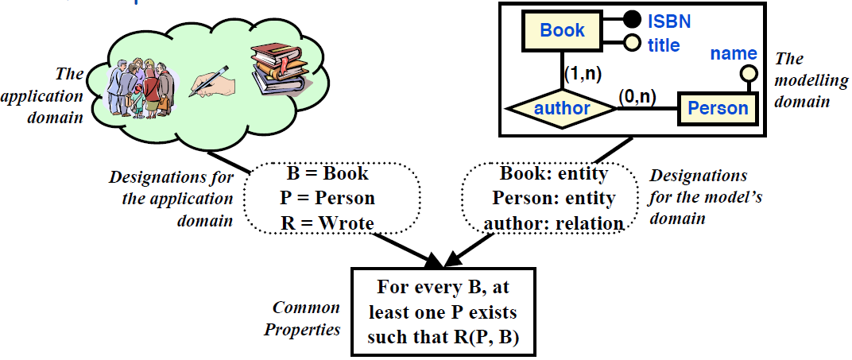
What is a Model
A model is more than just a description
it has its own phenomena, and its own relationships among those phenomena.
The model is only useful if the model’s phenomena correspond in a systematic way to the phenomena of the domain being modelled.

Slide 6
Why do we model?
Modelling can guide elicitation:
It can help you figure out what questions to ask
It can help to surface hidden requirements
i.e. does it help you ask the right questions?
Modelling can provide a measure of progress:
Completeness of the models -> completeness of the elicitation (?)
Modelling can help to uncover problems
Inconsistency in the models can reveal interesting things…
e.g. conflicting or infeasible requirements, confusion over terminology, scope, disagreements between stakeholders
Modelling can help us check our understanding
Reason over the model to understand its consequences
Does it have the properties we expect?
Animate the model to help us visualize/validate the requirements

Slide 7
The ways to model
Natural language
extremely expressive and flexible
very poor at capturing the semantics of the model
better used for elicitation, and to annotate models for communication
Semi-formal notation
captures structure and some semantics
can perform (some) reasoning, consistency checking, animation, etc.
e.g.; diagrams, tables, structured English
mostly visual - for rapid communication with a variety of stakeholders
Formal notation
very precise semantics, extensive reasoning possible
long way removed from the application domain

Slide 8
Business Modelling using UML
The first part of a business model is a business use-case model.
It consists of one or more use-case diagrams that contain one or more business use cases.
Business use cases are documented via specifications that are
partly text (most important: a workflow description) and
partly graphical (activity diagrams).
The business use-case model provides the big picture from a business actor's perspective.
Business use cases describe business processes.
These processes are documented as a sequence of actions that provide observable value to a business actor

Slide 9
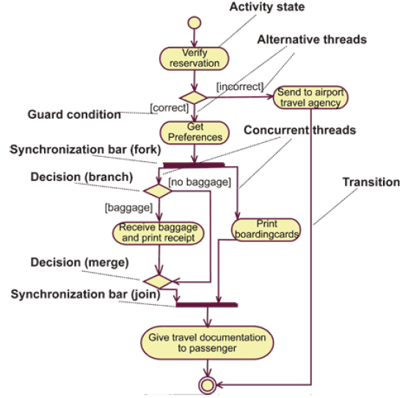
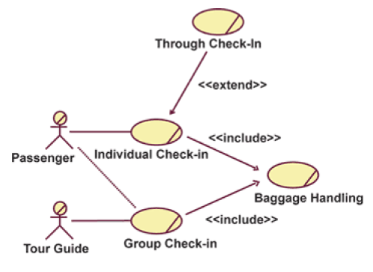
Business Modelling using UML

Slide 10
Business Object Model
The second part of a business model is the
business object model.
Whereas a business use-case model tells what a business process will do, a business object model tells how it will be done.
It serves as an abstraction of how business workers and business entities need to be related and to collaborate in order to perform the business.

Slide 11
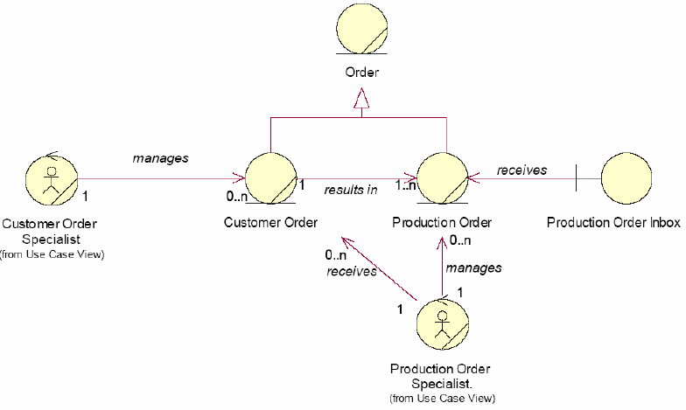
Business Object Model
Part of a business object model. It is a business class diagram showing business workers (the circles with stick figures) and business entities.

Slide 12
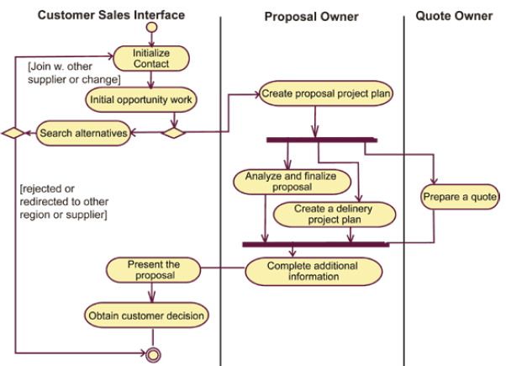
Another type of diagram used in a business object model is a variation of the activity diagram

Slide 13
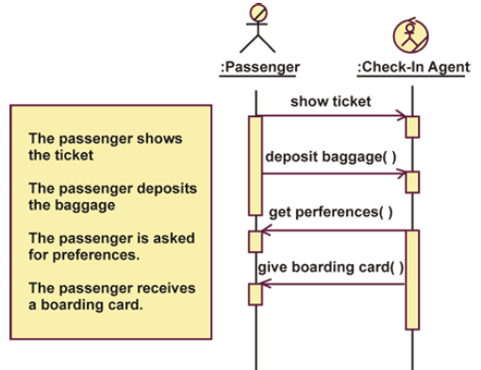
A third type of diagram used in a business object model is the business sequence diagram.
A sequence diagram briefly describes what participating business workers do, how they communicate by sending messages to one another, and how relevant business entities are manipulated.

Slide 14
root definitions
short textual statements which define the important elements of the relevant system being modelled - rather like mission statements
they follow the form:
a system to do X by (means of) Y in order to Z
what the system does - X
how it does it - Y
why it’s being done - Z

Slide 15
root definition examples
primary task (relating to basic tasks and structures)
A university owned and operated system to award degrees and diplomas to suitably qualified candidates (X), by means of suitable assessment (Y), (in conformance with national standards), in order to demonstrate the capabilities of candidates to potential employers (Z).
issue based (relating to temporary or qualitative concerns, or concerns of judgment)
A university owned and operated system to implement a quality service (X), by devising and operating procedures to delight its customers and control its suppliers (Y), in order to improve its educational products (Z).

Slide 16
CATWOE analysis
a check to ensure that root definitions contain most of what is important
Customers the victims or beneficiaries of T
Actors those who do T
Transformation input output
Weltanschauung the worldview that makes the T meaningful in context
Owners those with the power to stop T
Environmental elements outside the system which constraints are taken as given, but nevertheless affect its
behaviour
A system owned by O to do W by A by means of T given the constraints of E in order to achieve X for C.…
or any variation of the above that would form a paragraph and make sense when it is read.

Slide 17
example CATWOE
C candidate students
A university staff
T candidate students degree holders and diplomates
W the belief that awarding degrees and diplomas is a good
way of demonstrating the qualities of candidates to
potential employers
O the University governing body
E national educational and assessment standards

Slide 18
measures of performance
E1 - efficacy (does the system work, is the transformation effected)?
E2 - efficiency (the relationship between the output achieved and the resources consumed to achieve it)
E3 - effectiveness (is the longer term goal (Z) achieved)

Slide 19
measures of performance - example
E1 (efficacy) - are degrees and diplomas awarded?
E2 (efficiency) - how many degrees and diplomas, of what standard, are awarded for the resource consumed?
E3 (effectiveness) - do employers find the degrees and diplomas a useful way of assessing the qualities of potential employees?

Slide 20
the complete conceptual model
root definition
CATWOE
activity model
measures of performance

Slide 21
the complete model - example
design
education
programmes
enroll students
educate
students
allot
resources
appreciate
national
standards
award
degrees + diplomas
to students reaching
acceptable levels
design
and carry out
assessment
take control
action
monitor for
E1, E2, E3
E1 (efficacy) - are degrees and diplomas awarded?
E2 (efficiency) - how many degrees and diplomas, of what standard, are awarded for the resource consumed?
E3 (effectiveness) - do employers find the degrees and diplomas a useful way of assessing the qualities of potential employees?

Slide 22
Q&A

